Slide 1
URDU MACHINE READING COMPREHENSION (Research Based)
GROUP MEMBERS:
22-10457 (ERAJ KHURSHID)
22-10391 (SALMAN ANWAR)
22-10582 (ZAREK ASIF)
PRIMARY ADVISER: SIR ALI FAHEEM
SECONDARY ADVISER: SIR AKHEEM YOUSAF

Slide 2
OVERVIEW
PROBLEM STATEMENT
LITERATURE REVIEW
METHODOLOGY
EVALUATION
PROJECT MILESTONE
PROJECT COST
REFERENCES
QUESTIONS

Slide 3
PROBLEM STATEMENT
Machine Reading Comprehension is a cutting-edge technology in Natural Language Processing(NLP).
It’s the ability to read and understand unstructured text.
It is one of the key problems in Natural Language Understanding, where the task is to read and comprehend a given text passage, and then answer questions based on it.
It is a developing field of exploration because of its potential in different venture applications.
However, none of these models have been customized for the Urdu language.
Developing methods for Urdu machine reading comprehension for the users.
MRC which requires a machine to respond to questions given the pertinent reports.
It is a significant method for testing machines capacity to comprehend human language.
Urdu Machine reading comprehension is a difficult errand and interesting issue in natural language handling.
In the recent research paper, its present a thorough review on various parts of machine understanding comprehension frameworks, including their methodologies, structures, and exploration curiosities.

Slide 4
Literature Review
In 2015, CNN / Daily Mail (Hermann et al. 2015) and SQuAD (Rajpurkar et al. 2016) two large scale dataset were introduced in the field of MRC.
UQuAD1.0 which helps to investigate the semi-computerized formation of Urdu comprehension.
SQUAD dataset, which is basically an English dataset, and it is translated into Urdu through two ways. One method is through machine and other was human based survey.
Riloff and Thelen (2000) presented a rule-based MRC system called Quarc.
Akour et al. (2011) introduced the QArabPro system, which is a system for answering reading comprehension questions in the Arabic language.
Ng, Teo, and Kwan (2000) have developed a machine learning based MRC system and introduced some of features to be extracted from a context sentence.
Two main deep learning architectures used by MRC researchers are the Recurrent Neural Network (RNN) and Convolutional Neural Network (CNN).

Slide 5
Methodology
Datasets
The main challenge in Urdu MRC is non availability of database. So, we will be creating database using SQUAD and CNN/Daily Mail dataset.
SQUAD dataset is commonly used in most of the Papers related to MRC. So, we will be using SQUAD dataset.

Slide 6
Methodology
Algorithms
We will use different approaches for developing UMRC (Urdu Machine Reading Comprehension) system:
Rule based Model
This Model use a set of Rules written by linguistic experts.
Machine Learning based Model
This Model is based on the Classical machine learning. It rely on human-define features and train a model for mapping input.
Deep Learning based Model
This Model use Deep learning methods, which require a large-scale training data to achieve high accuracy.
Transformer Model
This Model aims to solve sequence-to-sequence tasks while handling long-range dependencies.

Slide 7

Evaluation
MRC Evaluation measures:
Two types of evaluation measures.
Extractive Metrics
Generic Metric

Slide 8
1. Extractive Metrics
F1 score:
It considers the system output and the ground-truth answer as bag-of-tokens (words).
Exact Match (EM):
This is the percentage of answers that exactly match with the correct answers.
Mean Average Precision (MAP):
This measure is used when the system returns several answers along with their ratings.

Slide 9
2. Generative metrics
Recall-Oriented Understudy for Gisting Evaluation (ROUGE):
This measure compares a system-generated answer with the human- generated one (Lin 2004).
BiLingual Evaluation Understudy (BLEU):
This metric first introduced for evaluating the output of machine translation task.

Slide 10
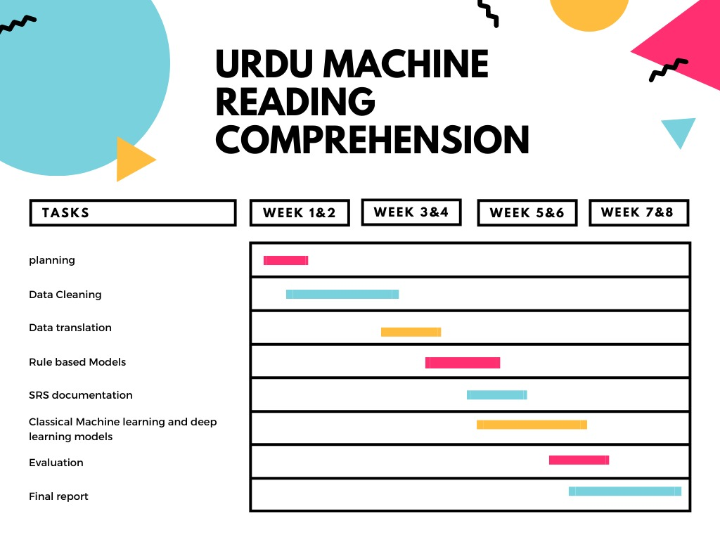
Project Milestone

Slide 11
Project Cost
There will be no costing for this project as this is research based and deep learning-based project
There will be no use of any hardware device.
We will b using Google translator which is free of cost.

Slide 12
References
Trung, L. H. (2019). https://euroasia-science.ru/pdf-arxiv/the-controllability-function-of-polynomial-for-descriptorsystems-23-31/. EurasianUnionScientists, 4(65). https://doi.org/10.31618/esu.2413 9335.2019.4.65.27
CiteSeerX — query based Arabic text summarization 1. (n.d.). Retrieved December 6, 2021, from https://citeseerx.ist.psu.edu/viewdoc/summary?doi=10.1.1.308.4480.
Zhao, M., Yan, S., Liu, B., Zhong, X., Hao, Q., Chen, H., Niu, D., Long, B., & Guo, W. (2020, October 28). QBSUM: A large-scale query-based document summarization dataset from real-world applications. Computer Speech & Language. Retrieved December 6, 2021, from https://www.sciencedirect.com/science/article/abs/pii/S0885230820300991.
Kumar, Y., Kaur, K., & Kaur, S. (2021, February 12). Study of automatic text summarization approaches in different languages. Artificial Intelligence Review. Retrieved December 6, 2021, from https://link.springer.com/article/10.1007/s10462-021-09964-4.
Nawaz, A., Bakhtyar, M., Baber, J., Ullah, I., Noor, W., & Basit, A. (2020, September 25). Extractive text summarization models for Urdu language. Information Processing & Management. Retrieved December 6, 2021, from https://www.sciencedirect.com/science/article/abs/pii/S0306457320308785.

Slide 13

Questions

